Slide 1
Deadpooled and Also-Rans
What Crunchbase tells us about location companies

Slide 2
Crunchbase
CrunchBase is the free database of technology companies, people, and investors that anyone can edit.
Open API: http://api.crunchbase.com/v/1/company/facebook.js
Yay, JSON!

Slide 3
Methodology
DFS (depth first search) of competitors belonging to selected companies (Foursquare, Gowalla, Loopt, Brightkite, SimpleGeo, etc)
Generate list of competitors, repeat DFS search on list
Yielded 1945 unique companies
Resulted in 1505 companies with data

Slide 5
Methodology
Initial attempt to segment on tags using hierarchical clustering. Tags were too unique, too sparse
Performed clustering using category tag
Reduced to 6 categories

Slide 6
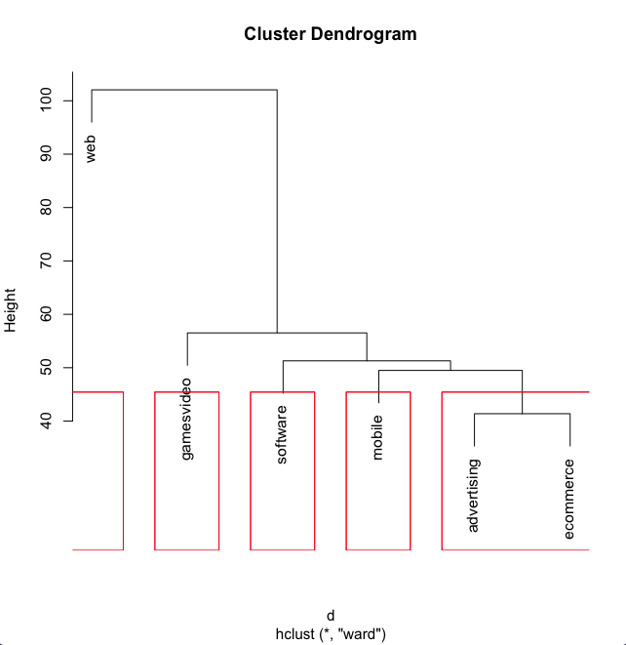
Higher in the plot occurs more frequently
Terms close to each other are more related

Slide 7
Raw counts
Category | Total | Acquired | IPO
advertising | 110 | 29 | 5
ecommerce | 114 | 18 | 8
games_video | 221 | 46 | 8
mobile | 182 | 34 | 6
software | 185 | 36 | 10
web | 693 | 136 | 13

Slide 8
Percentages
Category | Acquired | IPO
advertising | 26% | 5%
ecommerce | 16% | 7%
games_video | 21% | 4%
mobile | 19% | 3%
software | 19% | 5%
web | 20% | 2%

Slide 9
Adjusted IPO
Category | Raw | Percentage
advertising | 5 | 5%
ecommerce | 4 | 4%
games_video | 8 | 4%
mobile | 0 | 0%
software | 7 | 4%
web | 4 | 1%
* Removed companies not location focused

Slide 10

Acquiring Companies

Slide 11
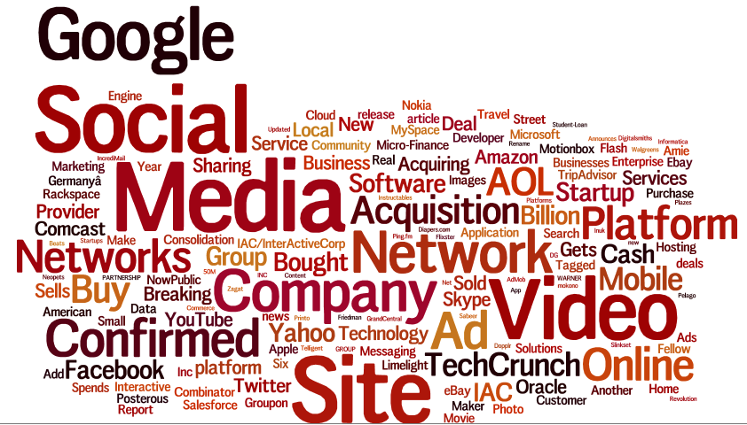
Media on Acquisitions

Slide 12
Amount Raised for Web
Count | 300
Mean | $31,183,226
Median | $5,900,000
Mode | $1,000,000
Minimum | $15,000
Maximum | $1,160,166,511
Range | $1,160,151,511
Sum | $9,354,967,849
* Skewed by FaceBook, Twitter, Groupon, Aol

Slide 13
Amount raised for Games
Count | 99
Mean | $21,756,267
Median | $11,015,719
Mode | $5,000,000
Minimum | $15,000
Maximum | $183,240,000
Range | $183,225,000
Sum | $2,153,870,470

Slide 14
Amount raised for mobile
Count | 92
Mean | $22,577,161
Median | $11,075,000
Mode | $4,000,000
Minimum | $11,000
Maximum | $168,000,000
Range | $167,989,000
Sum | $2,077,098,772

Slide 15
Parting thoughts
Crunchbase is a good starting point for data collection
Check SEC S-1 filings for IPOs
Scrape online for acquisitions (for amounts disclosed)
Verify which companies are still alive
Apologies for the teaser

Slide 16
Sophia Parafina
@spara
http://github.com/spara

